Slide 1
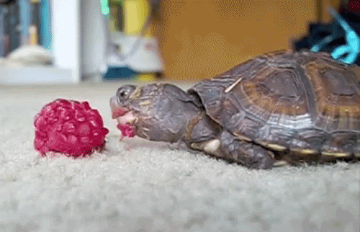
The Wonderful World of
Esters
Danielle and Kaitlyn

Slide 2
What is it? Properties:
Colorless liquids
Sweet, fruity smells
Soluble in alcohol
Reaction is reversible
Polar (less polar than alcohols)
Varying boiling points
Esters derive from carboxylic acids.
Contains the –COOH group
The hydrogen in this group is replaced with a hydrocarbon
ie. An alkyl group such as methyl or ethyl, or a benzene ring like phenyl

Slide 3
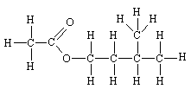
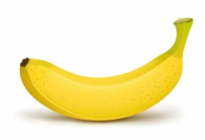
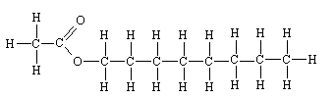
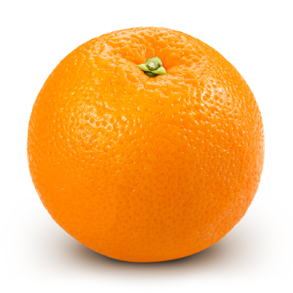
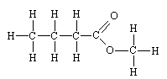

3- methylbutyl acetate
Octyl ethanoate
Methyl butanoate

Slide 4
General Formula
R-COOR’
Carboxylic acid
Ester!!
O
R-OH + C-R’ ⬄ R-O-C-R’ + H-O-H
HO O
Water!!
Alkyl group
Can be the same or different as “R”

Slide 5







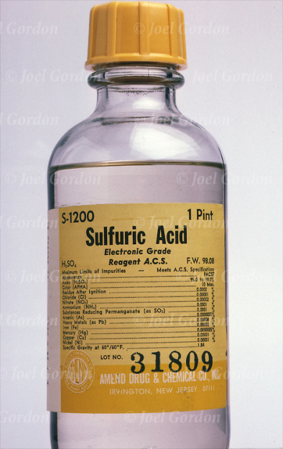
Synthesis!
HEAT
Alcohol
Carboxylic acid
ESTERIFICATION
Water
Ester

Slide 6

Reverse the reaction!
Can be broken down in a strong acid or base
Add water!!
“Hydrolyzed”, produces an alcohol and a carboxylic acid

Slide 7
Naming
Step 1: Name of alkyl group bonded to single-bonded “O” (R’)
Step 2: Name of carboxylic acid, “oic acid” ending replaced with “oate” (RCOO)
Step 3: Read backwards

Slide 8
Just in case…
https://youtu.be/KZhxI_i8jcE

Slide 9
The name of thrones
(Naming)
Notes:
Propyl ethanoate
3-methylbutyl acetate
Benzyl acetate

Slide 10
Resources
https://youtu.be/KZhxI_i8jcE
http://www.3rd1000.com/chem301/chem301v.htm
http://www.iceis.pl/drinki/drinki_przepisyh249.jpg
http://www.chm.bris.ac.uk/motm/ethylacetate/smells.htm
http://previews.123rf.com/images/haywiremedia/haywiremedia1302/haywiremedia130200025/18066081-A-young-boy-is-driving-a-box-car-with-a-wheels-thar-are-drawn-and-he-is-holding-a-steering-wheel-on--Stock-Photo.jpg
http://media.wilby.nu/2014/06/fEW6Y.jpg
http://i3.cpcache.com/product/78499651/hello_ester_ash_grey_tshirt.jpg?width=350&height=350&Filters
http://images.parentherald.com/data/images/full/47522/bucket-of-water.png
http://www.chm.bris.ac.uk/motm/ethylacetate/smells.htm
http://gustotv.com/wp-content/uploads/2014/12/shutterstock_84284302.jpg
http://images.all-free-download.com/images/graphicthumb/banana_310735.jpg
https://staticdelivery.nexusmods.com/mods/110/images/74627-0-1459502036.jpg
Prentice Hall Chemistry pg. 742
Modern Chemistry pg. 313-314
Notes:
Methyl ethanoate
Ethyl methanoate
Methyl benzoate

